Slide 1

Compiler Design
Divyaprabha K N
Assistant Professor,
Department of Computer Science & Engineering

Slide 2

Compiler Design
Unit 1
Symbol Table
Divyaprabha K N
Department of Computer Science & Engineering

Slide 3
Compiler Design Lecture Overview
In this lecture, you will learn about:
Symbol Table
Construction of symbol table

Slide 4

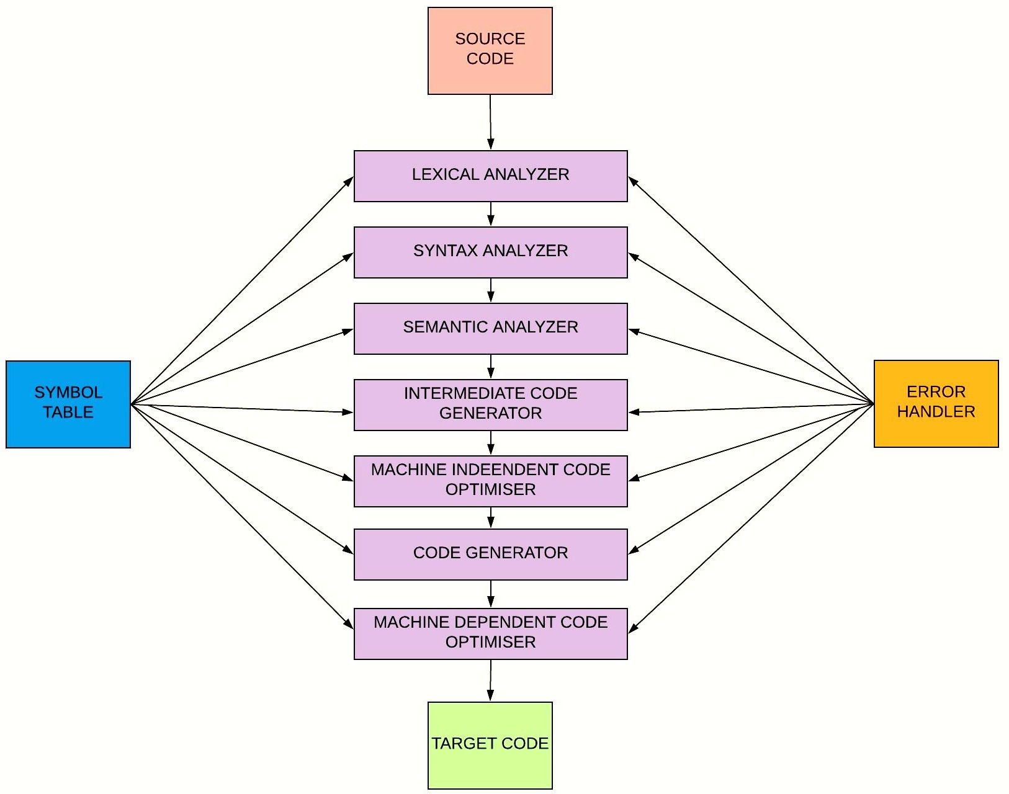
Compiler Design
7 Phases of Compiler
The compiler does its work in seven different phases and each
of them
have known as
an
access to
something
“Symbol “Error
Table” and to
Handler”.
These two entities are explained in the upcoming slides

Slide 5
Compiler Design Symbol Table
What is a symbol table?
Data structure containing a record for each variable name with fields for the attributes of the name
How does it look like?
Attributes provides the information about:
Storage allocation
Type
Scope (where in the program its value may be used)
Procedure names
Number and types of its arguments
Method of passing arguments (call by value or reference)

Slide 6
Compiler Design Symbol Table
Why symbol table?
Used during all phases of compilation
Maintains information about many source language constructs
Incrementally constructed and expanded during the analysis phases
Used directly in the code generation phases
Efficient storage and access important in practice

Slide 7
Compiler Design Symbol Table
When and where is it used?
Lexical Analysis time
Lexical Analyzer scans program
Finds Symbols
Adds Symbols to symbol table
Syntactic Analysis Time
Information about each symbol is filled in/updated
Used for type checking during semantic analysis

Slide 8
Compiler Design Symbol Table
More about symbol tables
Each piece of info associated with a name is called an attribute.
Attributes are language dependent.
Actual Characters of the name
Type
Storage allocation info (number of bytes).
Line number where declared
Lines where referenced.
Scope.

Slide 9
Compiler Design Symbol Table
Different Classes of Symbols have different attributes
Variable, Type, Constant, parameter, record field.
Type, storage, name, scope.
Procedure or function.
Number of parameters, parameters themselves, result type.
Array
# of Dimensions, Array bounds.
File
record size, record type

Slide 10
Compiler Design Symbol Table
Other attributes:
A scope of a variable can be represented by
A number (Scope is just one of attributes)
A different symbol table is constructed for different scope.
Object Oriented Languages Have classes like
Method names, class names, object names.
Scoping is VERY important. (Inheritance).

Slide 11
Compiler Design
Constructing the symbol table
There are three main operations to be carried out on the symbol table:
determining whether a string has already been stored
inserting an entry for a string
deleting a string when it goes out of scope
This requires three functions:
lookup(s): returns the index of the entry for string s, or 0 if there is no entry
insert(s,t): add a new entry for string s (of token t), and return its index
delete(s): deletes s from the table (or, typically, hides it)

Slide 12
Compiler Design
Constructing the symbol table
The two symbol table mechanisms: Linear lists and Hash tables
Each scheme is evaluated on the basis of time required to add n entries and make e inquiries.
A linear list is the simplest to implement, but its performance is poor when n and e are large.
Hashing schemes provide better performance for greater programming effort and space overhead.

Slide 13
Compiler Design
Constructing the symbol table (Example)
float fun2(int I, float j,){
int k,e;
float z; 4. ;
5. e=0;
6. k = I *j+k;
7. z = fun1(k,e,);
8. *z; }
Name | Token | Dtype | Value | Size | Scope | Other Attribute
 |  |  |  |  |  | Declared | Referred | Other
Fun2 | TK_ID | procname |  |  |  | 1
I | TK_ID | Int |  | 4 | 1 | 1 | 6 | parameter
j | TK_ID | float |  | 4 | 1 | 1 | 6 | parameter
k | TK_ID | Int |  | 4 | 0 | 2 | 6,7 | argument
e | TK_ID | Int | 0 | 4 | 0 | 2 | 7 | argument
z | TK_ID | Float |  | 4 | 0 | 3 | 7,8 | return
fun1 | TK_ID | procname |  |  |  | 7 |  | proccall
https://www.tutorialspoint.com/compiler_design/compiler_design_symbol_table.htm

Slide 14
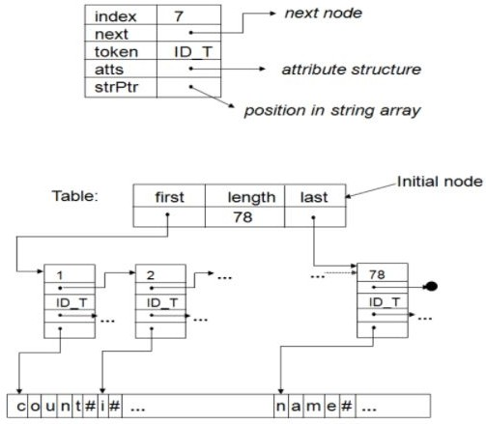
Compiler Design
Constructing the symbol table (Linked list implementation)
http://codingloverlavi.blogspot.com/2014/02/symbol-table-implementation-using.html

Slide 15
Compiler Design Symbol table and scope
Symbol tables typically need to support multiple declarations of the same identifier within a program
The scope of a declaration is the portion of a program to which the declaration applies.
We shall implement scopes by setting up a separate symbol table for each scope

Slide 16
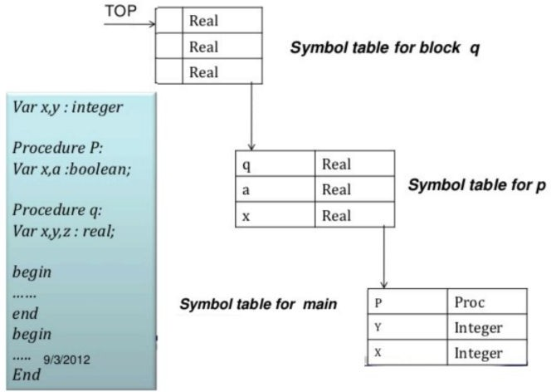
Compiler Design
Symbol table organization

Slide 17
THANK YOU
Divyaprabha K N
Department of Computer Science & Engineering
divyaprabha@pes.edu

